Slide 1

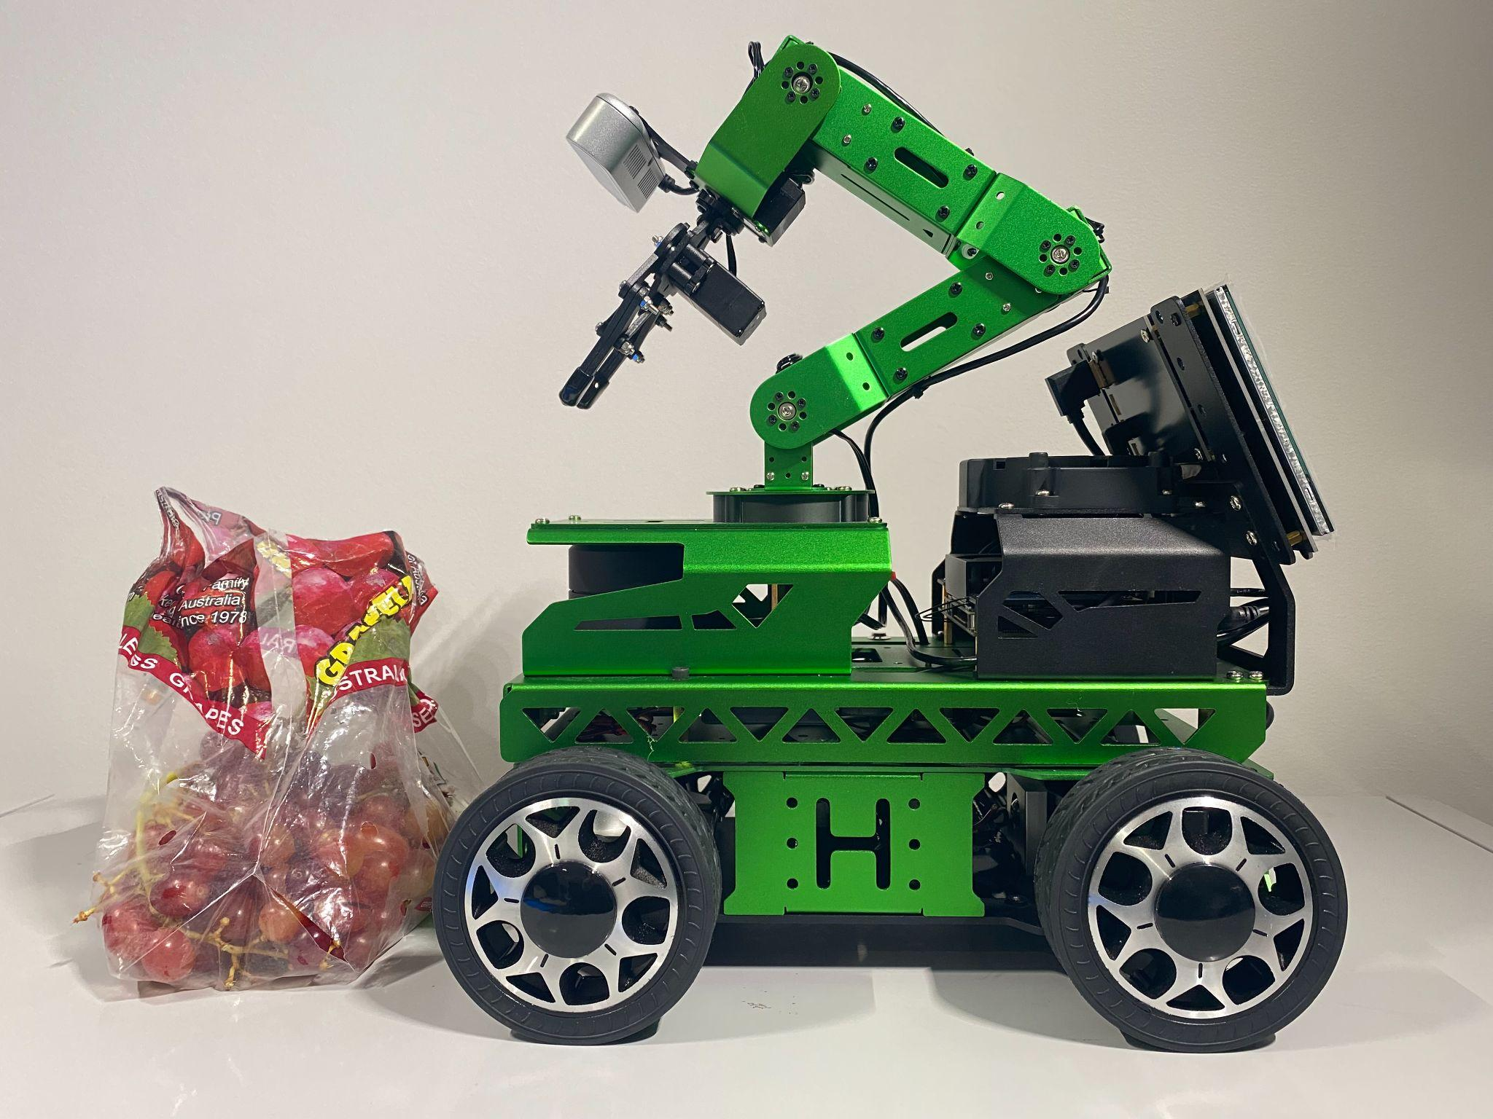
COMP8430 - ADVANCED COMPUTER VISION AND ACTION
GROUP PROJECT - PHASE 4 PRESENTATION
FINE-GRAINED FRUIT CLASSIFICATION
03
01
05
03
2
02
MEMBERS OF GROUP 3:
Student Name | Student ID
Phuong Thao (Jasmine) Huynh | 46248722
Prakhar Mishra | 48081906
Taha Naveed Shibli | 47892641
Gary Tze Hay Lau | 45245673
03
07
03
04
Notes:
Hello. My name is Gary. Today we are honour to have our group presentation : Fine-grained fruit classification. These are our team members : Taha ,prakhar and Jasmine.

Slide 2
TABLE OF CONTENTS
Introduction
- Our goal and the importance
of the project
03
Discussion and Lesson Learned
Challenge and further improvement
01
05
Data Collection & Challenges
- The way we collect our data
- Key lesson learnt
01
03
06
Group Contribution
02
02
System Architecture
Model choice for the robot
Pipeline and code modules
Reference
03
07
03
03
Results
Display our result
04
Notes:
Before we get start, I want to show the overview of our presentation today. We will talk in each point in these order.

Slide 3
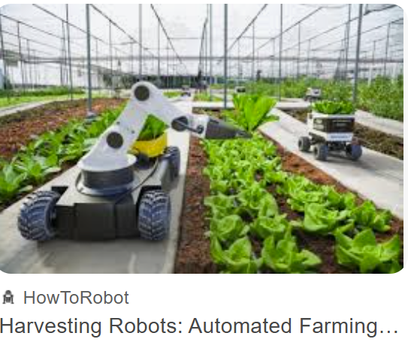
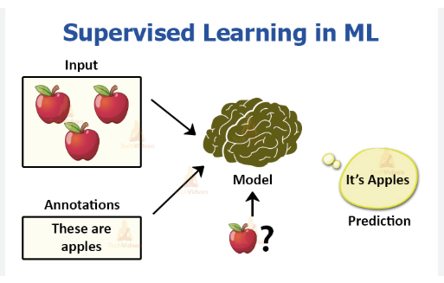

Introduction
The need of fine-grained fruit classification:
Eliminating the need for labels; reduces misclassification of similar shape and colour (Gill et al., 2022)
Image source: https://www.futurefarming.com/tech-in-focus/field-robots/australian-harves
Automating fruit labelling reduces labor costs (Apostolopoulos et al., 2023)
- Speed up logistics processing and efficiency with faster fine-grained fruit classification (Wu et al., 2024)
Image source: https://madhu.work/project/fruit_classification/
In conclusion:
We need to implement a model for robotic intra-class, fine-grained fruit classification
Image source: https://encrypted-tbn0.gstatic.com/images?q=tbn:ANd9GcTdprYl7160pzEkNxjqxys5Z9nDu-5YyO28-Q&s
Notes:
So why do we need fine-grained fruit classification?
Many fruits in similar type such as shape and colour are easily misclassified with manual labelling.
Developing a model might address such issue.
Automating labelling reduce the need for manual labor, spare money for company.

Slide 4

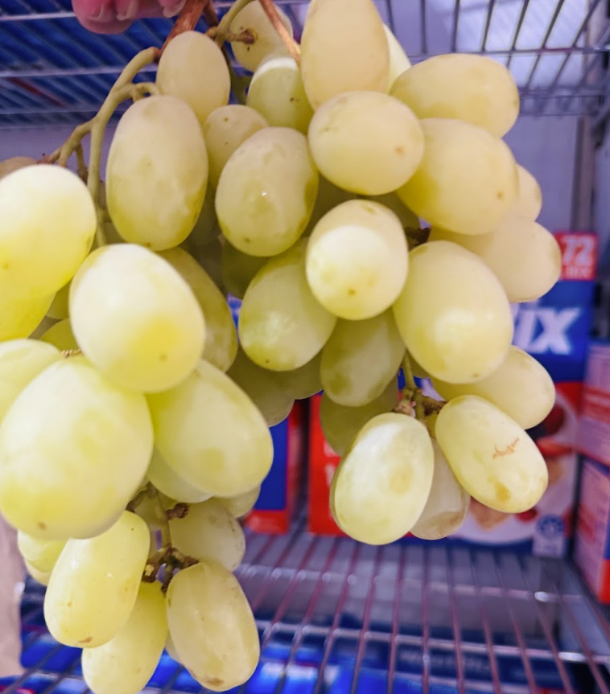

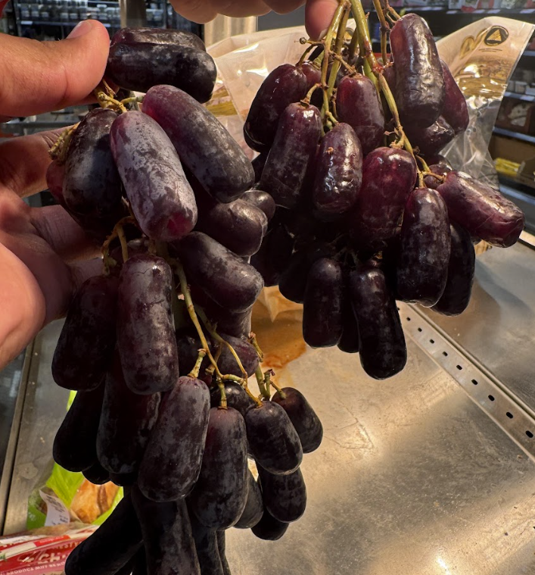
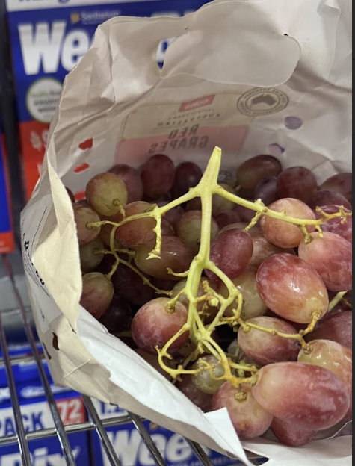
Introduction
The goal of our project:
To accurately classify fruits at an intra-class level, enable robots to respond accordingly.
Here are all the 21 categories of fruit :
Deploy the model on the robot
The robot perform specific 3 different actions based on the classifications of 3 selected classes (For simplicity)
Thompson Seedless
Autumn Royal
Crimson Seedless
Royal Gala Apple | Granny Smith Apple | Pink Lady Apple | Fuji apple | Jazz Apple | Kanzi Apple
Modi Apple | Snapdragon Apple | Navel Orange | Valencia Orange | Thompson Seedless Grape | Crimson Seedless Grape
Autumn Royal Grape | Cotton Candy Grape | Globe Grape | Cavendish Banana | Lady Finger Banana | Beurré Bosc Bear
Nashi Pear | Corella Pear | Red Angel Pear
Notes:
This lead to the goal of the project: To classify fruits at intra-class level and enable robots perform different action based on fruit classes. We deploy the model on the robot
This is the table all classes we want to classify{hand point here}).
For simplicity ,we only have 3 selected classes. - Thompson Seedless ,autumn Royal and Crimson Seedless for robot to act on.
Next, This is Taha turn.

Slide 5
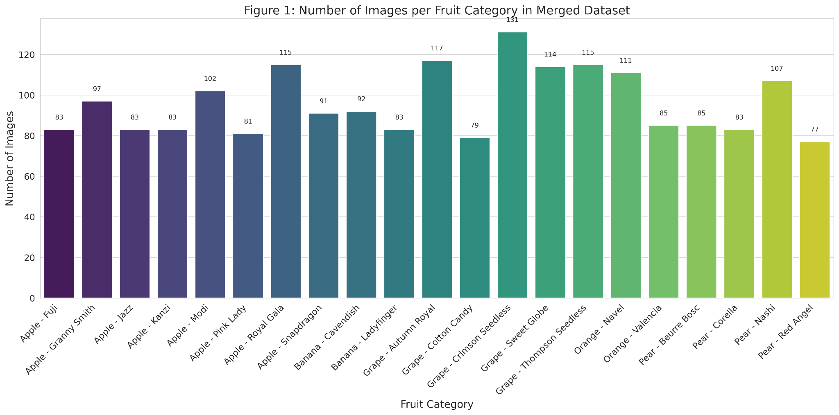
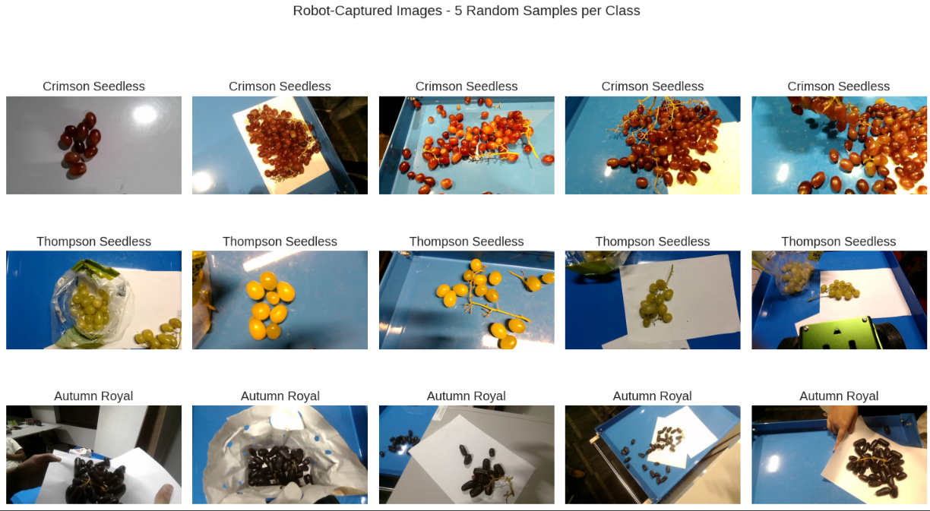
Data Collection & Challenges
Group dataset:
2,014 images
21 fruit classes
Collected manually by all members
Robot-Captured Dataset
165 images of 3 grape types captured using the robot’s camera.
Why grapes?
High visual similarity → perfect for fine-grained classification
Well-represented in earlier datasets
Thompson Seedless was often misclassified → chance to improve with fine-tuning
Challenges:
Collecting consistent images required multiple supermarket visits and manual effort.
Varying store environments caused uneven image quality and shadows.
Differences in ripeness stages altered appearance and introduced classification ambiguity.
Notes:
For this project, we worked with two main datasets.
The group dataset includes just over 2,000 images, covering 21 different fruit classes — all manually captured by our team. This formed the foundation for initial training and model development in earlier phases.
For robot deployment, we narrowed our focus to three grape types and collected 165 images using the robot’s camera. We chose grapes because they’re visually similar, which made them ideal for testing our model’s fine-grained classification ability. Also, they were well-represented in our earlier datasets, and Thompson Seedless had a high misclassification rate — making it a perfect candidate for improvement through domain-specific fine-tuning.
That said, collecting high-quality data wasn’t easy. We had to visit multiple supermarkets, often dealing with poor lighting, seasonal availability, and variation in ripeness — all of which made it harder to get consistent and balanced samples.

Slide 6
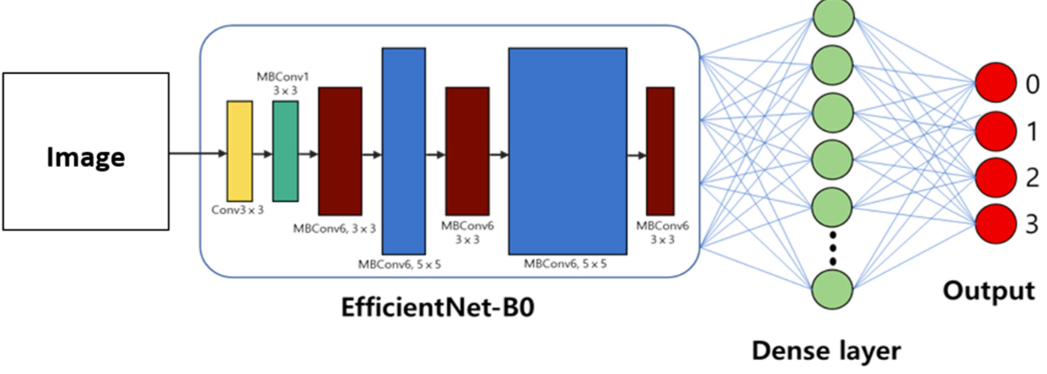
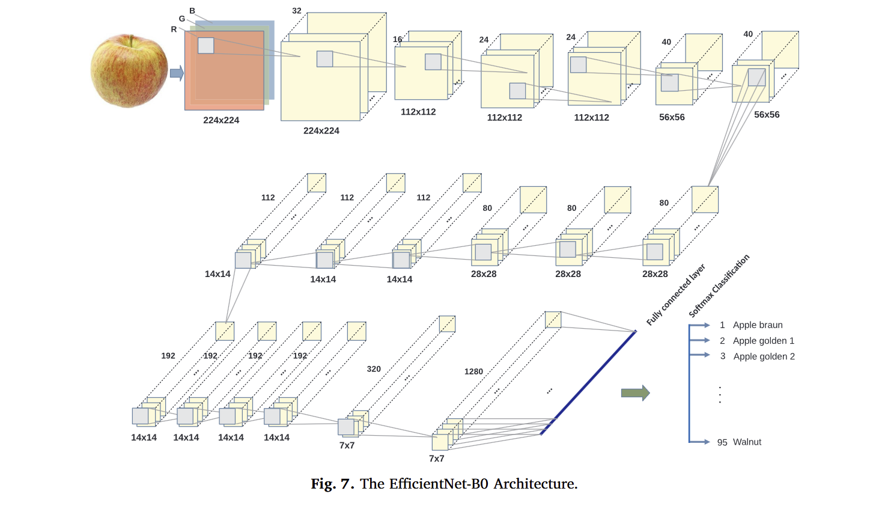
System Architecture
Model Choice – Efficient Net-B0
Source: https://www.mdpi.com/1999-4893/17/7/285
Source: https://ars.els-cdn.com/content/image/1-s2.0-S0168169919319787-gr7.jpg
Why We Chose Efficient Net-B0
Achieved 99.28% accuracy in Phase-2 | Optimized for fast inference on low-power devices
Lightweight: 5.3M parameters, 0.39B FLOPs | Performs well under varied lighting and background conditions.
Scales depth, width & resolution efficiently (compound scaling) | Outperformed larger models in accuracy–efficiency trade-off
Notes:
Let me begin by explaining why we chose EfficientNet-B0 for this project.
First, it gave us excellent results early on. In Phase 2, Jasmine achieved an accuracy of 99.28% using this model—better than any other candidate we tested. Then in Phase 3, when we trained it on our combined dataset of over 2,000 fruit images, it performed just as well—delivering consistent, high accuracy.
A study by Mimma et al. in 2022, where EfficientNet-B0 achieved 98.3% accuracy on the Fruits360 dataset. That reinforced our confidence in its performance on fruit classification tasks like ours. So, we wanted to test how well it did in real-world deployment.
What truly sets EfficientNet apart is how it scales. It uses something called compound scaling, which means it balances model depth, width, and input resolution together— which leads to better generalization.
Lastly, it’s incredibly lightweight—just 5.3 million parameters and 0.39 billion FLOPs. That low complexity means it runs quickly even on devices with limited computing power.
For our project, we selected EfficientNet-B0, and here’s why. First, it gave us excellent results in testing. Jasmine achieved 99.28% accuracy using this model in Phase 2, which outperformed all other candidates.
Second, EfficientNet-B0 is lightweight, with just 5.3 million parameters and 0.39 billion FLOPs, which means it runs quickly even on devices with limited computing power. But more importantly, it uses compound scaling—balancing model depth, width, and resolution all at once, which leads to better generalization.
This lightweight nature made it a perfect fit for our robot, where real-time processing and low power usage were essential. So, for our application, fine-grained fruit classification on a moving robot, EfficientNet-B0 offered the right mix of speed, accuracy, and deployability.
Let me begin by explaining why we chose EfficientNet-B0 for this project.
During earlier testing phases, one of our group members, Jasmine, achieved 99.28% accuracy using this model, which was the highest among all tested. But what really made it stand out was its efficiency.
EfficientNet-B0 is designed to scale evenly across depth, width, and resolution using a method called compound scaling, which you can see in the diagram here. Despite its compact size, only 5.3 million parameters and 0.39 billion FLOPs, it delivers impressive performance.
And most relevant to our project: EfficientNet-B0 consistently handled difficult real-world conditions like changes in lighting, angles, and backgrounds during image capture—exactly the kind of environment our robot operated in.

Slide 7
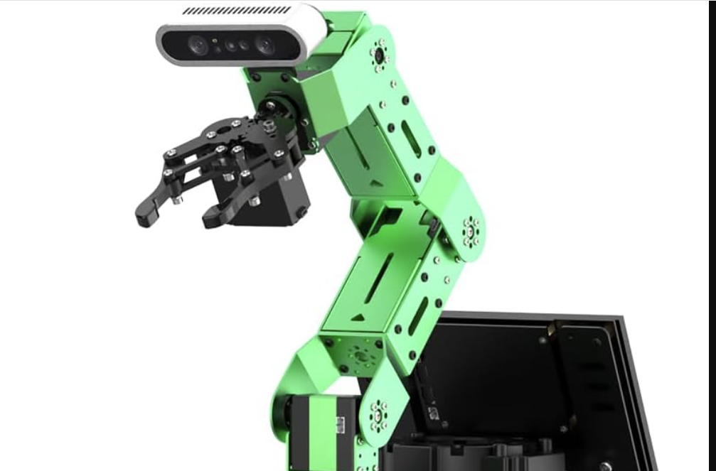
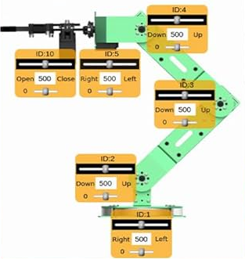
System Architecture
Code Modules
📸 capture_robot_image/ → modified capture topic.
capture_sub.py:
Original Week 8 code saved every camera frame → redundant data
We introduced manual, on-demand capture using the Enter key
Ensures only clear, intentional frames are stored reducing noise, and saves storage.
🧠 robot_image_classifier/ → custom inference node.
model_wrapper.py:
Loads fine-tuned Efficient Net-B0 model
Restores class-to-index mapping
inference.py
Runs classification
Triggers robot arm movement based on predicted class
Notes:
In Week 8, the capture node saved every frame from the robot's camera, even the blurry and redundant ones. So we rewrote it. Our version adds a keyboard-triggered capture. Using Python’s threading module and input(), we wait for the user to press Enter, and then store just one clear frame. This change gives us better control and improves image quality.
For system integration, we divided our code into two main modules: one for image capture and another for inference.
The capture_sub.py node, located in capture_robot_image, allows us to manually capture images using the Enter key. This approach gives us better control over image quality and avoids saving unnecessary frames.
The robot_image_classifier module contains two files. model_wrapper.py loads our fine-tuned model and restores the class-to-index mapping. Then inference.py initialises our inference node, classifying the image and sending movement commands to the robot arm.
This modular design ensures each component operates independently, making the system easier to debug and maintain.
====================================================================================================================
In the robot_image_classifier module, model_wrapper.py loads our fine-tuned EfficientNet-B0 model and restores the class-to-index mapping. Then the inference.py node handles real-time predictions and sends movement commands to the robot arm using ROS messages.
This modular design ensures each component operates independently, making the system easier to debug and maintain.

Slide 8


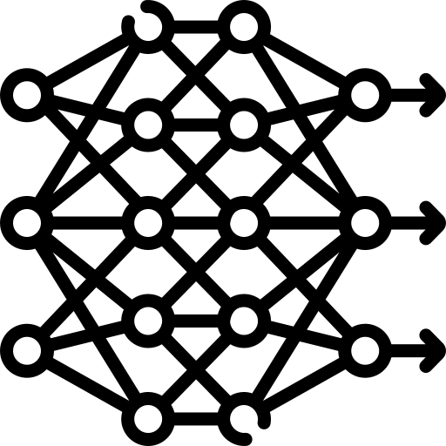

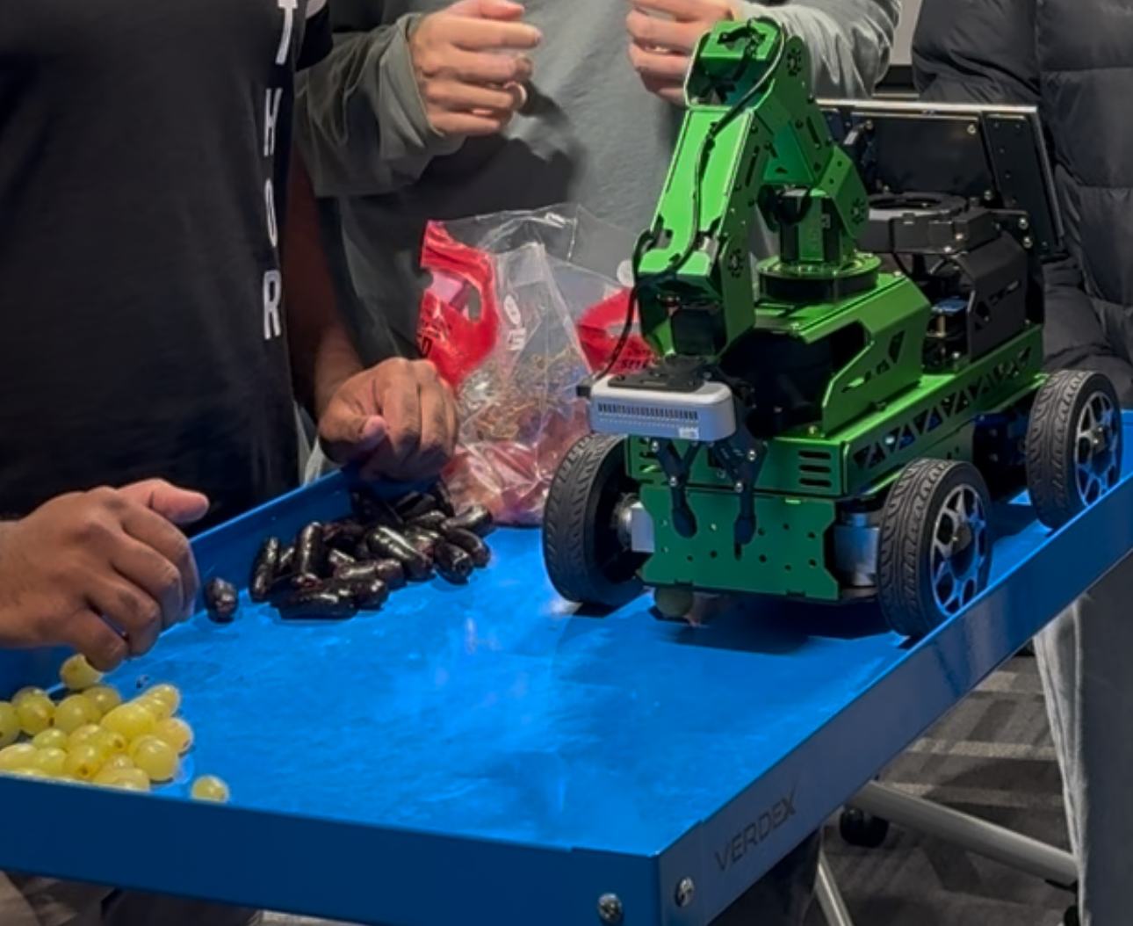
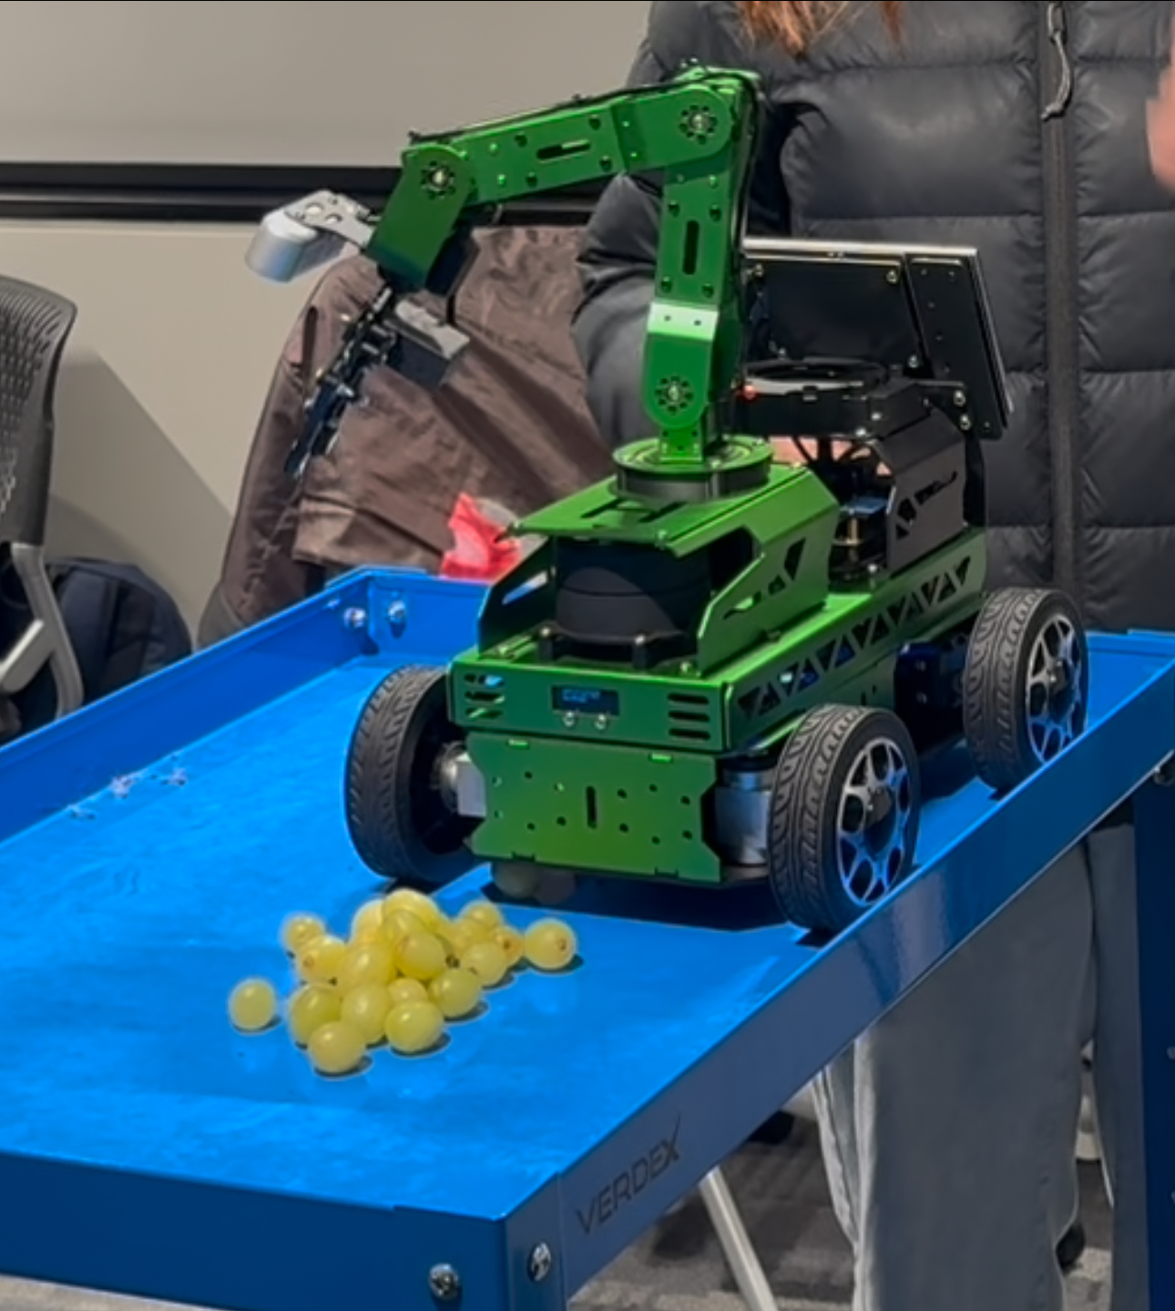
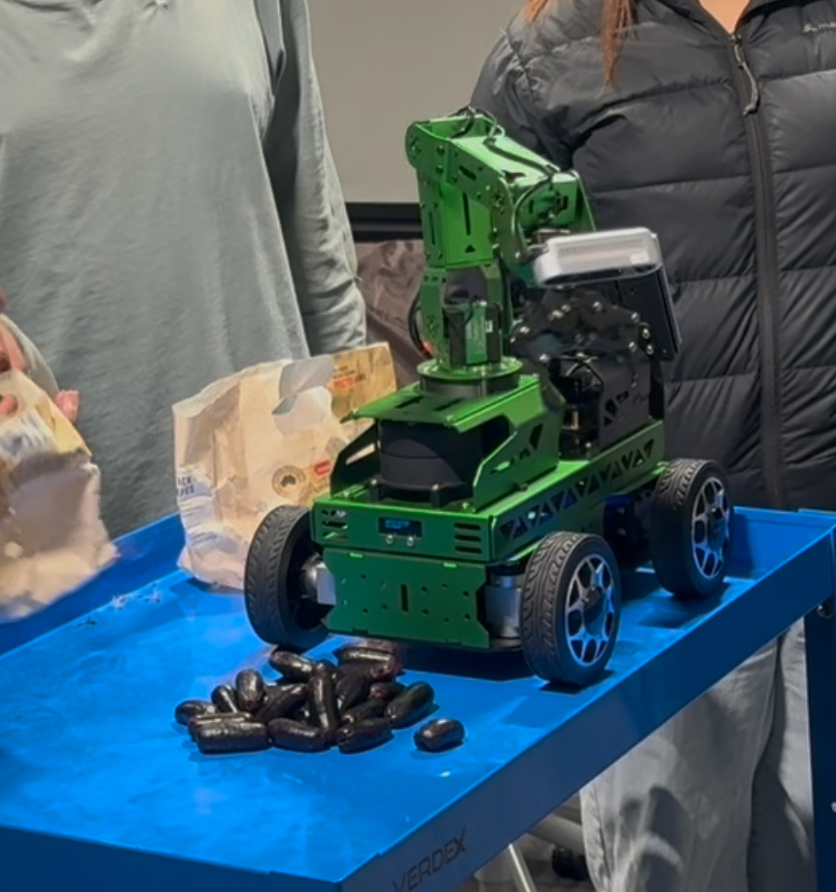
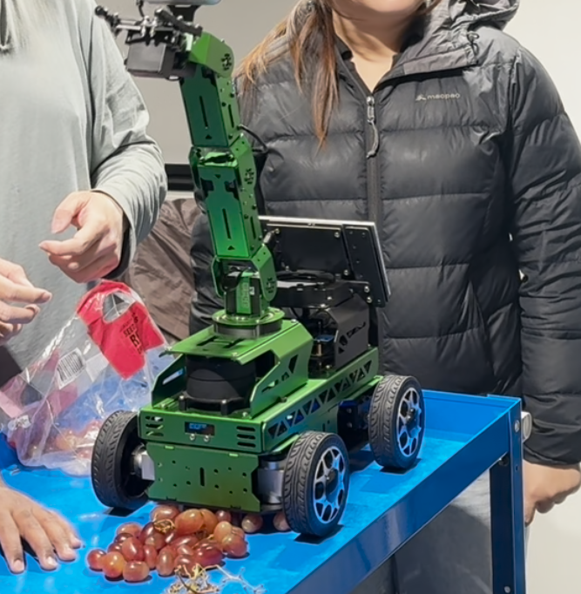
System Architecture
Pipeline
Leverage the robot’s camera to create a steady stream of images.
Use CV Bridge to convert from ROS binary blob to NumPy array in BGR order.
Pre-process the image to prepare for fine-tuned EfficientNet-B0 model.
Feed image into the model to obtain predicted class and confidence score.
If confidence score > threshold, then depending on the class of grapes, perform corresponding movement.
Default | Thompson Seedless | Autumn Royal | Crimson Seedless
Default state of the arm | Low rightward reach | Low leftward reach | Straight upward extension
Notes:
Now I’ll talk about the pipeline.
First, we leverage the robot’s camera to keep taking images as input.
Then we pre-process the image for our fine-tuned EfficientNet-B0 model, before feeding it in. We then obtain a predicted class and its confidence score.
If the confidence score is greater than our threshold, then it triggers the arm to perform an action. This depends on the class.
As you can see, Thompson Seedless makes it go right, Autumn Royal makes it go left, and Crimson Seedless makes it go straight up.
============================================================================================================
First, we leverage the robot’s camera node to create a steady stream of images. We then use CV Bridge to convert the encoding of each image from a ROS binary blob to a NumPy array in BGR order.
We pre-process the image - switching the channels to RGB order, converting it to Tensor, and applying normalisation. We then feed it into our fine-tuned EfficientNet-B0 model to obtain a predicted class and a confidence score.
If the confidence score passes a certain threshold, then depending on the predicted class of grapes, we send a corresponding message to the Bus Servo. The message tells the robot the positions of each arm joint.

Slide 9
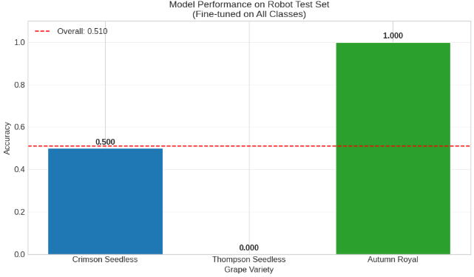
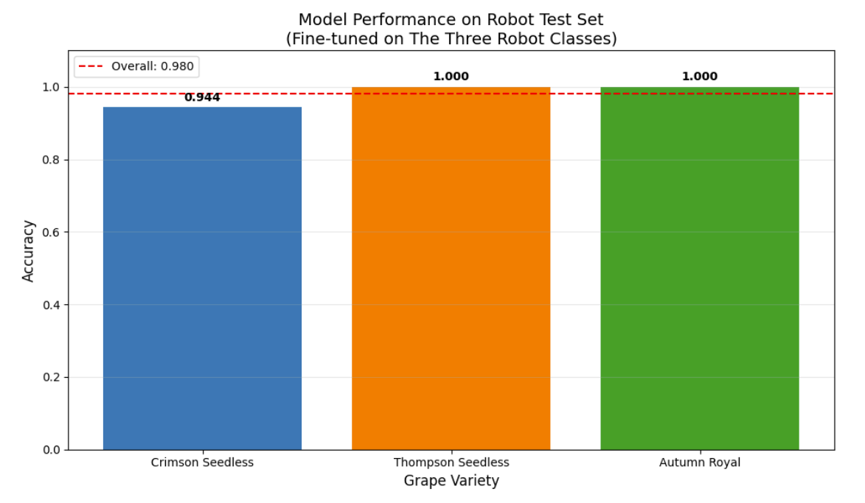
Result
Domain-specific fine-tuning drastically improves overall accuracy, especially for Thompson Seedless.
Fine-tuning balances performance across all classes
Notes:
Let me now walk you through our results.
On the left is the model fine-tuned on all 21 fruit classes from our combined dataset.
When evaluated on the robot-captured grape images, the overall accuracy was just 51%.
Most notably, it completely failed to classify any Thompson Seedless grapes correctly.
Now, on the right is the model fine-tuned only on the 3 robot-captured grape classes.
This domain-specific fine-tuning made a huge difference. The model’s accuracy jumped to 98.04%.
Thompson Seedless, which was previously misclassified every time, now had perfect accuracy.
The key takeaway here is that fine-tuning on robot-specific data drastically boosts real-world performance, especially when classes look very similar, like these grapes.
===================================================================================================================
Let me now walk you through our results.
We first tested the model that was fine-tuned on all 21 fruit classes from our group dataset. When evaluated on the robot-captured grape images, the overall accuracy was just 51%. Most notably, it completely failed to classify any Thompson Seedless grapes correctly.
To address this, we retrained the model, but this time, only on the three grape classes captured using the robot’s own camera. This domain-specific fine-tuning made a huge difference. The model’s accuracy jumped to 98.04%, correctly classifying 50 out of 51 test images. Thompson Seedless, which was previously misclassified every time, now had perfect accuracy.
These charts show the before-and-after comparison, and below you can see how the robot’s arm responds differently to each class. These movements confirm that the classification is not only accurate but also triggers the right physical action.
The key takeaway here is that fine-tuning on robot-specific data drastically boosts real-world performance, especially when classes look very similar, like these grapes.

Slide 10
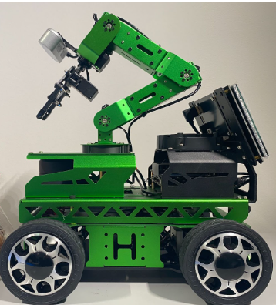



DISCUSSION AND LESSON LEARNED
CHALLENGES
Training on static images, deploying on robot-captured images with different conditions.
Different camera sensors on robots introduced inconsistencies.
ROS 2 rebuilds: Time-consuming debugging due to full environment rebuilds after changes.
Limited robot battery life constrained testing sessions.

Slide 11
DISCUSSION AND LESSON LEARNED
KEY LESSONS
01
Ensure alignment between data collection and deployment conditions (fixed camera vs. handheld data).
01
Ensure alignment between data collection and deployment conditions (fixed camera vs. handheld data).
02
02
Test across multiple hardware units to ensure robustness.
02
Test across multiple hardware units to ensure robustness.
Test across multiple hardware units to ensure robustness.
02
03
Streamline debugging workflow by explore modular testing and containerization.
03
Streamline debugging workflow by explore modular testing and containerization.
03
Streamline debugging workflow by explore modular testing and containerization.
04
Balance accuracy with real-time inference speed for practical deployment.
03
04
05
Collaboration and clear communication were crucial for overcoming challenges and achieving a successful result.

Slide 12

GROUP CONTRIBUTIONS
Dataset merging and preprocessing
Robot image preprocessing
Fine-tuning models on the full group dataset
Contributed to report writing & slides (30%)
Cross-checked and supported Prakhar work
SHARE TASK:
Led robot setup and testing during practicals
Practical session preparation (e.g., fruit selection, task setup)
Implemented Python scripts for robot deployment (inference, actions).
Contributed information and feedback for report writing
Provided mutual support and cross-checked each other’s work
Contributed to report writing & slides (40%).
JASMINE
GARY
GROUP 3
MEMBERS
TAHA
Robot image fine-tuning and action mapping.
Contributed to report writing & slides (30%).
Video editing
Cross-checked and supported Jasmine work
PRAKHAR

Slide 13
REFERENCES
Apostolopoulos, I. D., Tzani, M., & Aznaouridis, S. I. (2023). A general machine learning model for assessing fruit quality using deep image features. AI, 4(4), 812–830. https://doi.org/10.3390/ai4040041
Duong, L. T., Nguyen, P. T., Di Sipio, C., & Di Ruscio, D. (2020). Automated fruit recognition using EfficientNet and MixNet. Computers and Electronics in Agriculture, 171, 105326. https://doi.org/10.1016/j.compag.2020.105326
Gill, H. S., Khalaf, O. I., Alotaibi, Y., Alghamdi, S., & Alassery, F. (2022). Multi-model CNN-RNN-LSTM based fruit recognition and classification. Intelligent Automation & Soft Computing, 34(3), 1351–1365. https://doi.org/10.32604/iasc.2022.022589
Macquarie University. (2025). Practical resources for COMP8430: Advanced computer vision and action (Weeks 4, 8–9). Unpublished course materials.
Wu, T., Miao, Z., Huang, W., Han, W., Guo, Z., & Li, T. (2024). SGW-YOLOv8n: An improved YOLOv8n-based model for apple detection and segmentation in complex orchard environments. Agriculture, 14(11), 1958. https://doi.org/10.3390/agriculture14111958

Slide 14



THANK YOU

